Slide 1


Slide 2
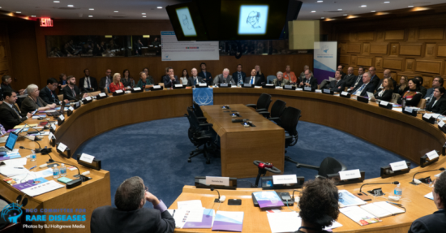
NGO Committee for Rare Diseases
The formal inauguration of the Committee took place at the UN Headquarters in New York on11 November 2016

Slide 3


Slide 4
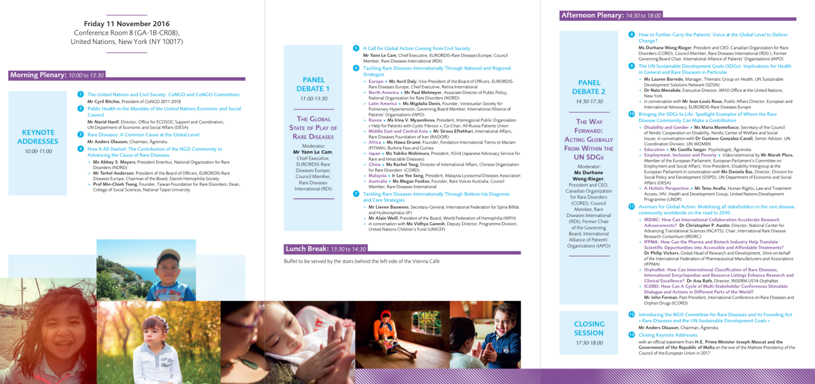

Slide 5
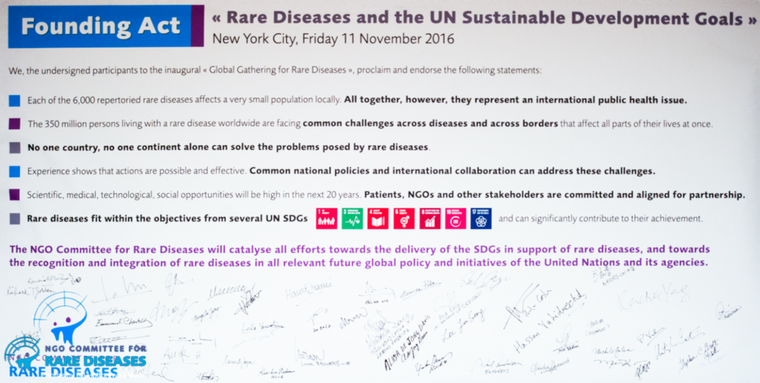
A milestone in the journey to put rare diseases in the global agenda

