Slide 2
LEAVE NO ONE BEHIND: why rare diseases are important for the global health agenda
Yann Le Cam
Chief Executive Officer of EURORDIS - Rare Diseases Europe
Member of the Council of Rare Diseases International

Slide 3
What is a rare disease?
A rare disease in Europe is a disease
affecting less than 1 in 2,000 citizens
Over 6,000 distinct rare diseases
6 to 8% of the population over lifespan
60 million people living with a rare disease in Europe and USA
300 million people living with a rare disease in the world
All ages, mostly children
Some main groups: metabolic, neuro-muscular, autoimmune, developmental anomalies, bleeding disorders, cardiovascular, respiratory, skin diseases, rare cancers…

Slide 4
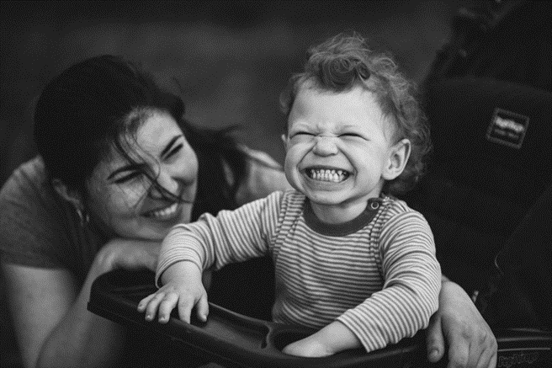
Characteristics of Rare Diseases
Chronic, progressive, degenerative, disabling and frequently life-threatening
Patients are few and geographically scattered
Experts are few and geographically scattered
Reliable information is scarce
Research is fragmented
Resources are limited
Sustainability is an issue

Slide 5
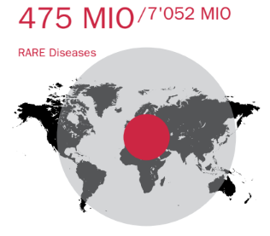
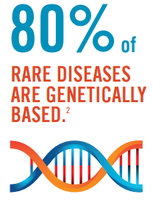
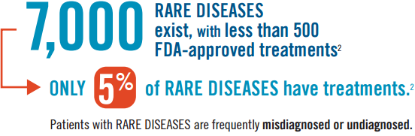
The impact of rare diseases in the world
No one country, no one continent, can solve alone the problems posed by rare diseases
300

Slide 6
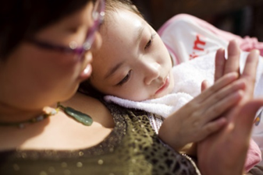
Rarity calls for action at the global level
No one country, no one continent, can solve alone the problems posed by rare diseases
Need to bring together a critical mass of patients and medical experts, scientists and public health authorities.
Need to support countries emerging to rare diseases, researchers and medical experts international collaboration companies acting at global level
Civil society empowerment at international level

Slide 7
Need for a common prevalence of rare diseases
United States: less than 7.5 in 10,000 people
(less than 200,000 individuals in the US population)
Population: 318,463,000
Canada: no more than 5 in 10,000 people
Population: 35,427,524
EU: no more than 5 in 10,000 people
(less than 1 in 2,000 citizens)
Population: 507 416 607
Brazil: 6.5 in 10,000 people
(1.3 in 2000 people)
Population: 202,914,000
Mexico: no more than 5 in 10,000 people
Population: 119,713,203

Slide 8
Need for more Rare Diseases & Orphan Drugs Regulations
1983: USA: The Orphan Drug Act (ODA)
(promoted by the National Organization for Rare Disorders NORD)
1991: SINGAPORE
1993: JAPAN
1997: AUSTRALIA
1999: EU Regulation on Orphan Drugs
(EURORDIS strongly advocated for this
Regulation)
Other parts of the world lagging behind

Slide 9
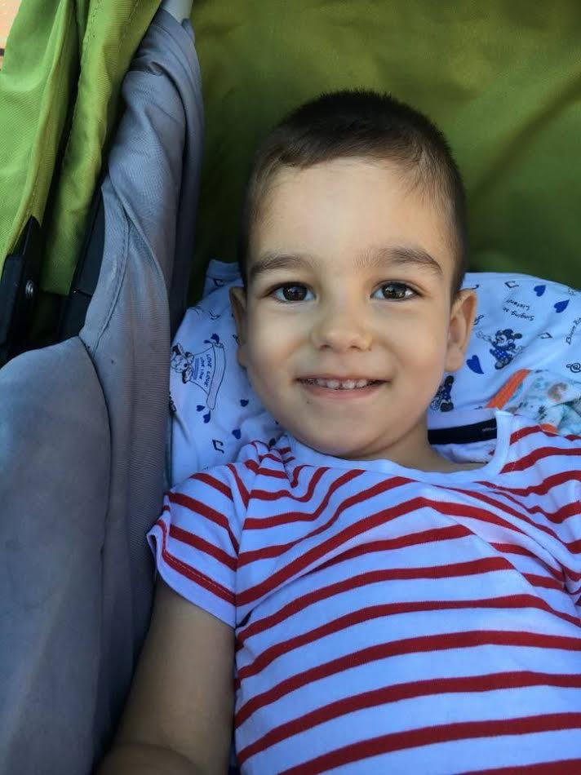
Challenges & Hopes
Rare Diseases greatly differ from each other, great heterogeneity, affect different organs, different disabilities, different ages
Different health systems, gaps in economic and social development across the world North/South divide
However there are commonalities across all rare diseases. They share many of the same challenges and issues in all parts of the world which allows for common healthcare policies
In the 21st century, new opportunities from translational research, innovative regulatory science, and information technologies :
Enable more and earlier diagnosis
Bring more quality care and innovative treatments to patients
Increased access and flow of information
Create networking opportunities globally, encourage partnerships

Slide 10
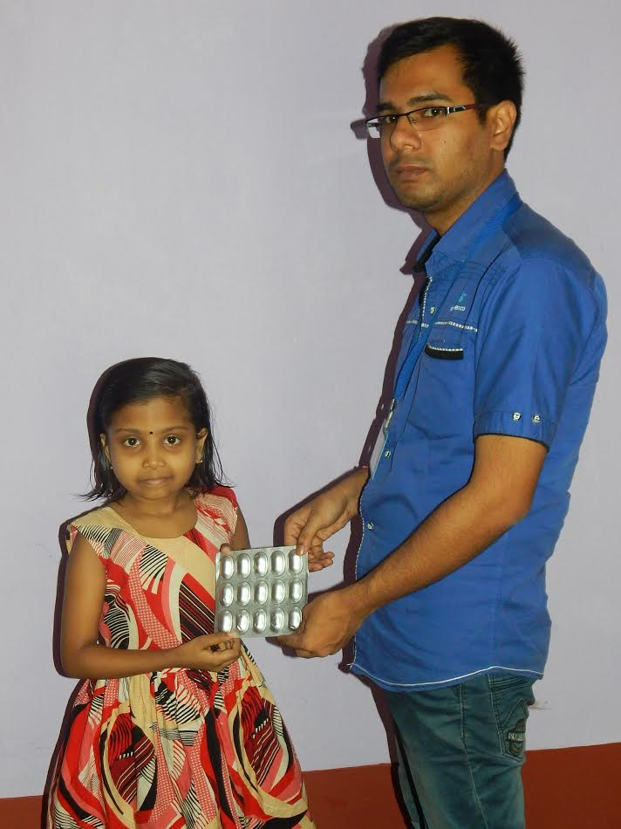
The globalisation of Rare Diseases is underway
RD policies & Regulations are in place in several countries
Development of National Plans / Strategies worldwide
Increased investments in RD Research : IRDiRC, increased budget of the US NIH or EU dedicated to RD Research…
Increasing international networking amongst scientists (ReACT Congress + e-Rare)
Increased investments from industry thanks to incentives (market exclusivity) provided by legislations (EU, US, Japan..°
Increased collaboration amongst international medicines agencies (EMA & FDA); EU-WHO Data Sharing Pact
Development of international platforms for RD patient data sharing, diagnostic, clinical research,
Rare disease patients getting organised across borders

Slide 11
Rare diseases international
What is Rare Diseases International (RDI)?
The Global Alliance of rare disease patients and their families of all nationalities across all rare diseases.
Where does it come from?
RDI is a joint initiative with National Alliances from around the world (Europe, USA, Canada, Latin America, Japan, Australia, China, Russia) with whom EURORDIS have signed partnership agreements, sharing the same international vision and common objectives.
«To be a strong common voice for rare disease patients across the world»

Slide 12
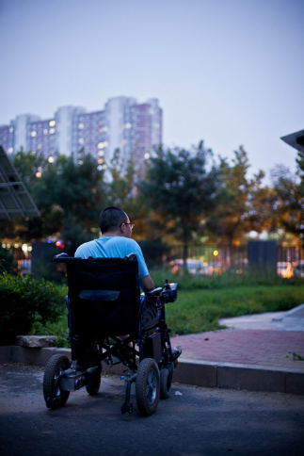
vISION
RDI recognises that,
People living with a rare disease are facing similar challenges irrespective of where they live in the world
People living with a rare disease share a common interest to address their comparable or specific needs
Through its work, the hope is that RDI will ensure that:
People living with a rare disease worldwide and their families will experience better recognition and support improved health or social services, and overall, better life
RDI is purpose-driven, principles-led and patient-driven

Slide 13
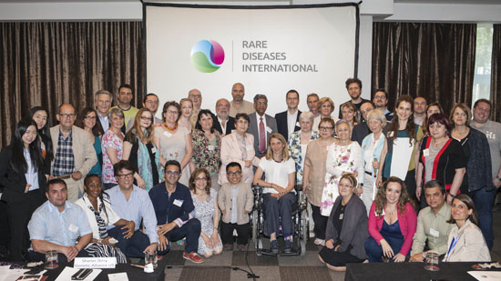
RDI Launch EVENT mAY 28, 2015 MADRID, SPAIN

Slide 14
44 member organisations
26 National Alliances from all regions of the world
3 Regional Umbrella Organisations or Networks (Europe, Ibero-Latin America, Asia-Pacific)
9 International Federations
6 Associate Members

Slide 15
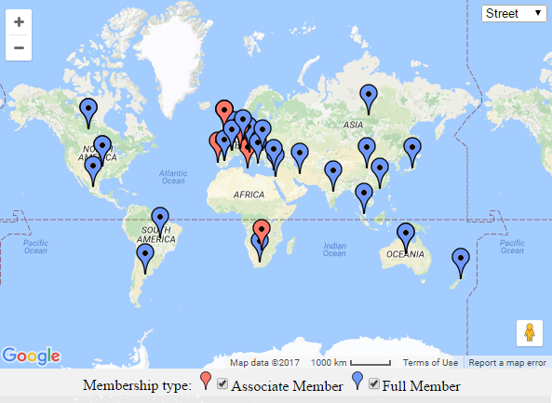
representing patients in more than 60 counTRIES
44 member organisations

Slide 16
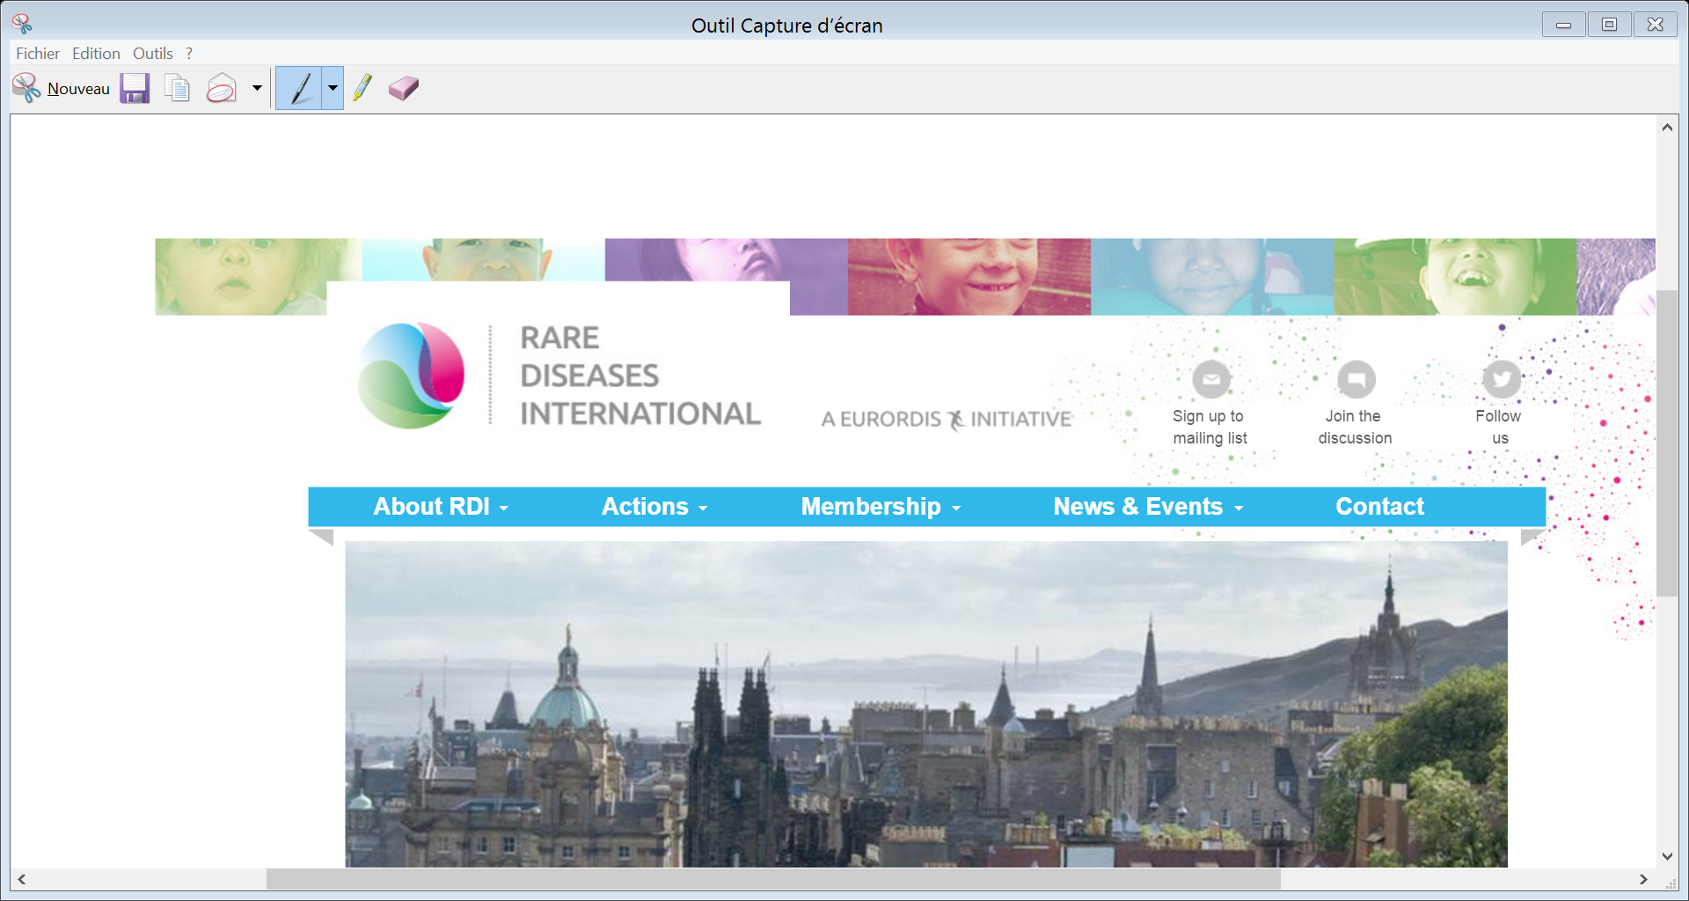
www.rarediseasesinternational.org @rarediseasesint

Slide 17
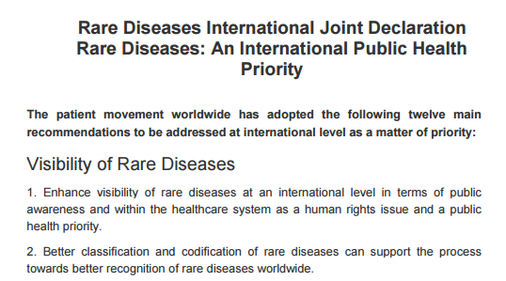
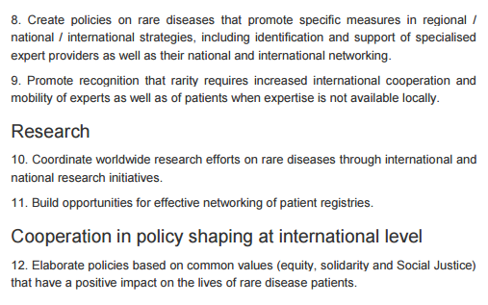
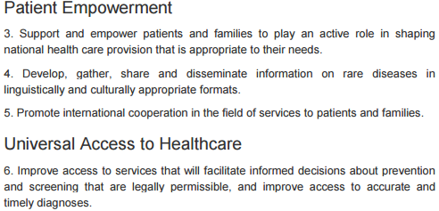
Joint Declaration “Rare Diseases: An International Public Health Priority”

Slide 18
NGO Committee for Rare Diseases
What is the NGO Committee for Rare Diseases?
A substantive committee established under the umbrella of the Conference of NGOs in Consultative Relationship with the United Nations (CoNGO) to promote rare diseases as a priority in global health, research, and social and medical care as part of the UN 2030 Agenda: the Sustainable Development Goals (SDGs).
Who is involved?
It is an initiative by the Ågrenska Foundation and EURORDIS – Rare Diseases Europe in cooperation with Rare Diseases International (RDI)
Supported by 34 NGOs from CoNGO
Composition of members in 2017
Multi-stakeholder, mostly NGOs, members ECOSOC,
relevant institutions, individual experts

Slide 19
NGO Committee for Rare Diseases
What for?
To increase visibility of rare diseases at the global level
To connect NGOs interested in rare diseases and their partners through a global platform
To elevate rare diseases as a global public health priority
To fight discrimination against people living with rare diseases worldwide

Slide 20
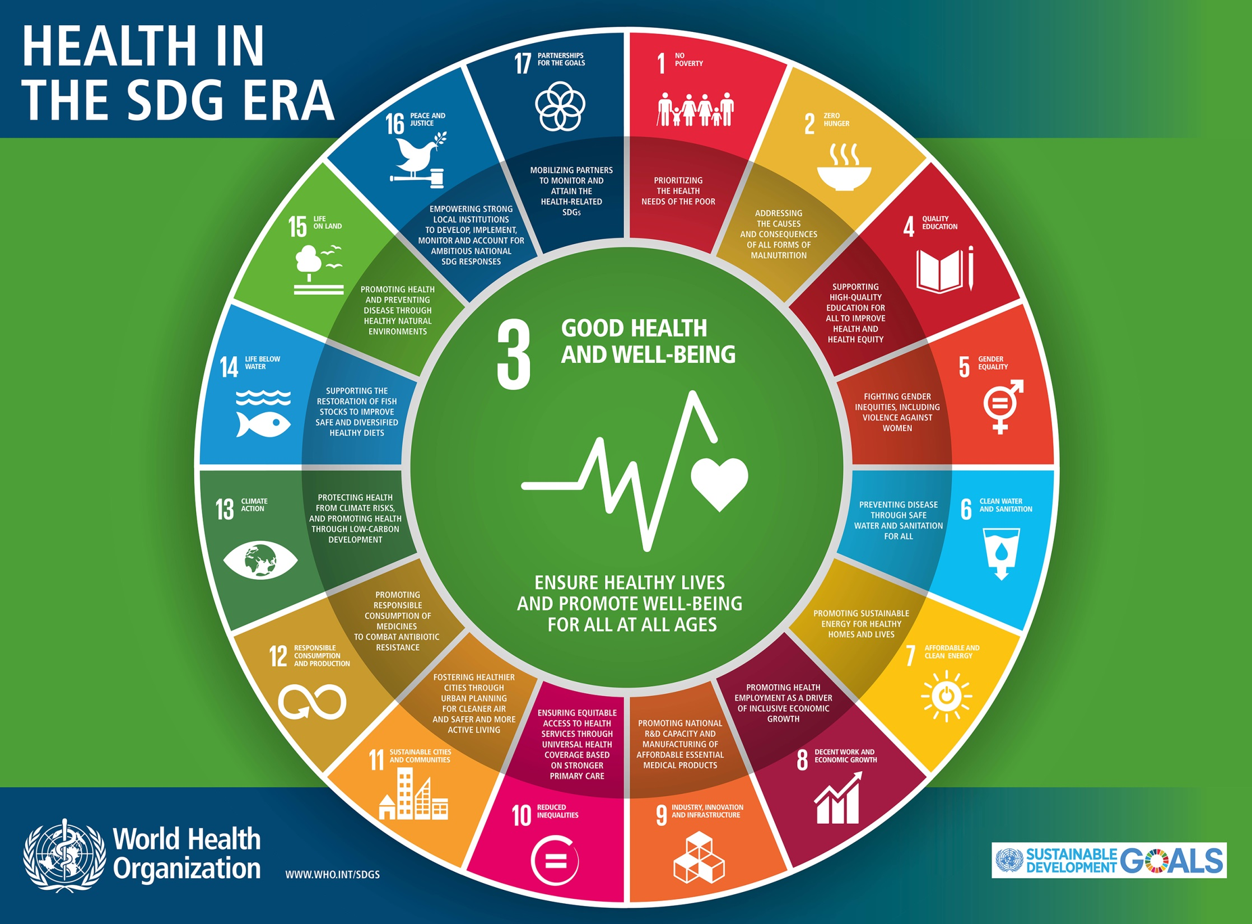

Slide 21
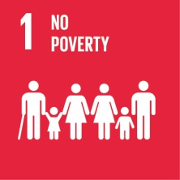
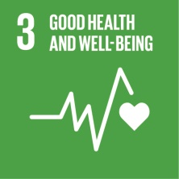
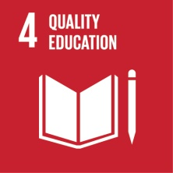
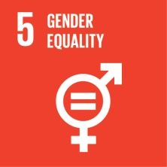
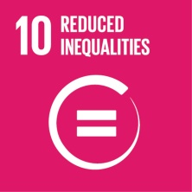
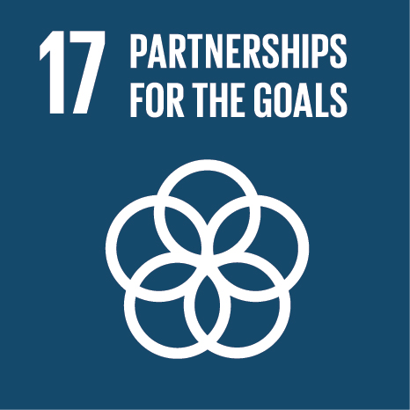
THE 2030 Sustainable development agenda AND Rare diseases
The Sustainable Development Agenda adopted by the United Nations in November 2015 constitutes an opportunity to address the specific issues faced by people living with a rare disease
There is a clear alignment between a number of SDGs and Rare Diseases
The most obvious one being SDG 3 to ‘ensure healthy lives and promote well-being for all at all ages’

Slide 22
The synergies between the Sustainable Development Goals and rare diseases
Sustainable Development Goals |  | Rare Diseases Challenges
Goal 1 End Poverty in all its forms everywhere |  | Persons with rare diseases are often trapped in a vicious cycle of vulnerability and poverty due to exclusion from health care and education systems, as well as job markets
Goal 3 Ensure healthy lives and promote well-being for all at all ages |  | Achieving universal health coverage implies attending to the needs of persons living with a rare disease who need more and better medicines, appropriate diagnosis and lifelong care and social support
Goal 4 Ensure inclusive and equitable quality education and promote lifelong learning opportunities for all |  | 50% of rare diseases affect children who often face difficulties attending school due to inaccessibility of facilities and non-adapted teaching methods
Goal 5 Achieve gender equality and empower all women and girls |  | Recognising and valuing unpaid care and domestic work that many mothers of children (including when they are grown adults) with rare diseases take on will be a step towards greater gender equality

Slide 23
The synergies between the Sustainable Development Goals and rare diseases
Sustainable Development Goals |  | Rare Diseases Challenges
Goal 8 Promote sustained, inclusive and sustainable economic growth, full and productive employment and decent work for all |  | Persons with rare diseases are often trapped in a vicious cycle of vulnerability and poverty due to exclusion from health care and education systems, as well as job markets
Goal 9 Build resilient infrastructure, promote inclusive and sustainable industrialization and foster innovation |  | Achieving universal health coverage implies attending to the needs of persons living with a rare disease who need more and better medicines, appropriate diagnosis and lifelong care and social support
Goal 10 Reduce inequality within and among countries |  | 50% of rare diseases affect children who often face difficulties attending school due to inaccessibility of facilities and non-adapted teaching methods
Goal 17 Revitalise the global partnership for sustainable development |  | Recognising and valuing unpaid care and domestic work that many mothers of children (including when they are grown adults) with rare diseases take on will be a step towards greater gender equality

Slide 24
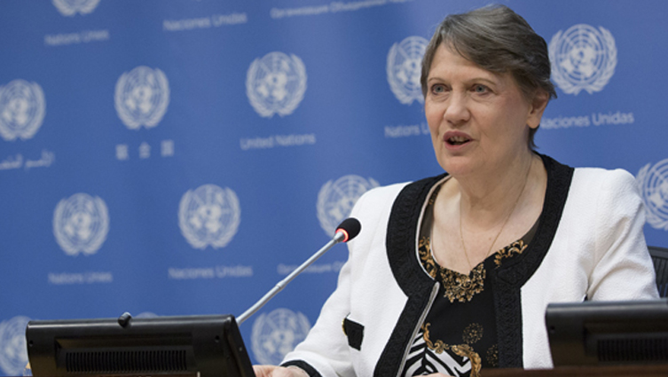
Universal health coverage: what about rare diseases?
One of the key commitments under Goal 3, “ensuring healthy lives for all”, is to achieve universal health coverage and provide “access to safe, effective, quality, and affordable essential medicines and vaccines for all”.
The research on and development of health technologies is an important element of universal health coverage.
‘No country can claim to have achieved universal healthcare if it has not adequately and equitably met the needs of those with rare diseases’
Helen Clark, Administrator of the UN Development Programme

Slide 25
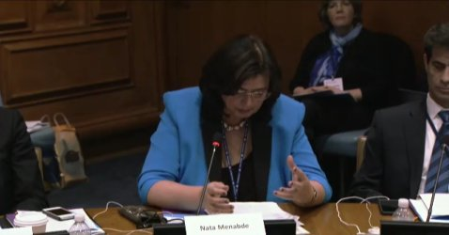
Leave no one behind
"If we are serious about leaving nobody behind we cannot leave behind those living with rare disease just because they are few“
Nata Menabde, Executive Director, World Health Organization Office at the United Nations

Slide 26
Thank you

