Slide 1
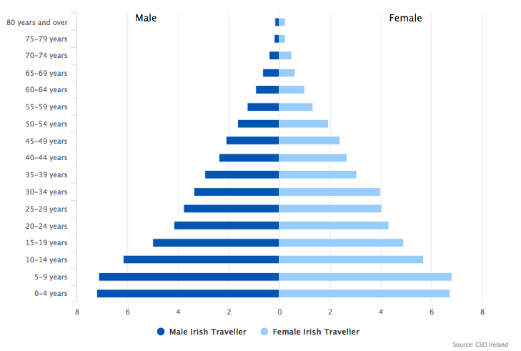
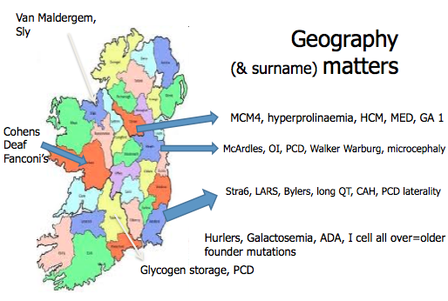
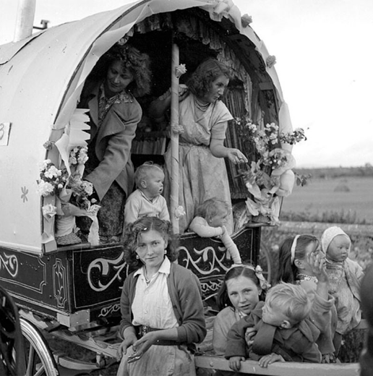
HEALTH AND DISEASE IN CHILDREN OF THE IRISH TRAVELLER COMMUNITY
G294(P)
O’Reilly PJ, Jenkinson A, Martin T, Power B, Stone G, Murphy AM
University Hospital Limerick, Ireland
Background
Aims
Results
Irish Travellers are a Roman Catholic, endogamous, minority group with origins dating back to the 12h century.
Their ethnicity was finally recognised by the Irish Government in March 2017.
Latest estimates put their numbers at 40,129 on the Island of Ireland, 15,000 in the United Kingdom, 6,000 on Mainland Europe and 7,000 in America.
Nomadism and family are core features of their identity. Early and arranged marriage, frequent child bearing and consanguinity are cultural norms.
Our aims were to collate current data on morbidity and mortality of Traveller children
And to examine how their health needs might influence planning of services and provision of healthcare
Between 650 and 850 Traveller babies are born on the Island of Ireland every year.
Main causes of mortality are accidents, congenital malformations and inherited metabolic disorders.
To date 93 different genetic disorders are reported in Irish Travllers, 82 of which the genetic basis is known. There are more than 60 founder mutations.
The commonest disorders are Galactosemia, Hurler syndrome and I- Cell disease, the carrier frequency for which is 1/11, 1/11 and 1/15 respectively.
Methods
A Literature and database(s) search was conducted and relevant clinicians contacted in an effort to compile data on the complexity and heterogeneity of the modern Irish Traveller Community to inform appropriate action in the area of Traveller Child Health.
Figure 2: Parts of Ireland were certain conditions are found more frequently in the Traveller population
Figure 1: The Traveller population is in Stage 1 to 2 of the demographic transition model with high birth and death rate. The general Irish population is in Stage 3
Healthcare Provision for Irish Travellers: The Difficulties
Conclusions
Young population:
39.7% of Travellers are under 15 years of age
Only 8 Travellers found to be over 85 years of age
The Infant mortality rate is 3.5 times that of the general population.
10% of Traveller children are dead before their second birthday.
Risk of suicide is a significant issue: 6.6 times higher in Traveller males compared with the general Irish population
Peripatetic existence: 95% still travel part of the year
Nomadic mindset: “To live free and clear of yesterday”
Religion: “Prefer to leave things in the hands of God”
Superstition: “If you speak of the ill or the dead you bring their bad luck on yourself”
Stigma: “Nobody will marry Winnie now because of Johnny’s sickness”
Distrust of the settled community: Historical hostility still exists
Our study highlights the huge disease burden imposed on Traveller children by the combination of circumstances.
Several factors effect their health including:
Poverty
Increased frequency of genetic disorders in consanguineous communities
Peripatetic lifestyle and nomadic mindset
Superstition, stigma and distrust
Our study provides useful epidemiological information with particular reference to the healthcare needs of minority groups marginalised in our society.
References
1. Government of Ireland census 2002; 2006; 2011; 2016 www.cso.ie
2. All Ireland Traveller Health Study (AITHS) 2010
3. Catalogue of inherited disorders found among the Irish Traveller population, SA Lynch et al. J Med Genet. 2018 Jan 22. pii: jmedgenet-2017-104974. doi: 10.1136/jmedgenet-2017-104974
4. Travellers, Citizens of Ireland, The Parish of the Travelling People: Murphy F & McDonagh C (2000)
5. National Library of Ireland on The Commons (Picture)
Notes:
Copy and paste your content into the relevant boxes.
Feel free to amend the number of columns/rows/headings to suit your poster.
Make sure to consult the design specifications for posters for the conference or meeting your poster will be displayed at – some have specific layout requirements. Particularly, check if the layout should be portrait or landscape.
Make sure you include the logos of any funders and other partner institutions. If there is any logo that is missing from the left hand side, email cormacmcadam@rcsi.ie and we’ll track a high quality version down.
If you need any assistance in designing or printing your poster, email cormacmcadam@rcsi.ie

